Slide 1

Lock & Thread
Computer System Engineering, Fall 2018. (IPADS, SJTU)
Before-or-after
Yubin Xia

Slide 2

Virtualization: C/S on a Single Machine
in order to enforce modularity + build an effective operating system
programs should not be able to refer to
(and corrupt) each others’ memory
Virtual memory
programs should be able to
communicate
Bounded buffer (virtualize communication links)
programs should be able to share a
CPU without one program halting the
progress of the other
Assume one program per CPU (for today)

Slide 3
Review: Primitives to Implement Lock
Hardware atomic instruction
RSM: read-set-memory
Test-and-set, Compare-and-swap
Load-linked + Store-conditional, Fetch-and-add
Software solution
Using load and store instructions only
Dekker’s & Peterson’s Algorithms

Slide 4
Peterson’s Algorithms
int flag[2]; // assume two threads on two CPUs
int turn;
void init() {
flag[0] = flag[1] = 0; // 1->thread wants to grab lock
turn = 0; // whose turn? (thread 0 or 1?)
}
void lock() {
flag[self] = 1; // self: thread ID of caller
turn = 1 - self; // make it other thread’s turn
while ((flag[1-self] == 1) && (turn == 1 - self))
; // spin-wait
}
void unlock() {
flag[self] = 0; // simply undo your intent
}

Slide 5
Peterson’s Algorithms
Assumptions
Assume loads and stores are atomic with respect to each other, which was true on early hardware
Does not hold on today’s hardware, which has relaxed memory consistency models
So, not used any more
Using a little hardware support is much easier

Slide 6
Assumptions of Atomic Instructions
Bus arbiter
Guarantees that any single LOAD or STORE is a before-or-after action with respect to every other LOAD and STORE
Each entry of the shared array is:
in its own memory cell
the memory provides read/write coherence for memory cells
The instructions execute in program order

Slide 7

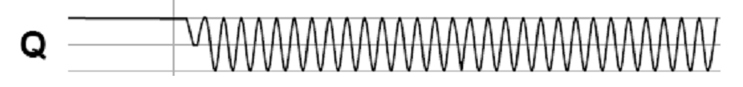
The Bus Arbiter Problem
A:
Arbiter
S:
A:
B:
Clock:
B:
Clock:
S:
t_{E}
Two async inputs (A, B), one sync output
Choose between two asynchronous input
If inputs are closely spaced
Output may be oscillating
Waiting longer only reduce the probability of oscillating

Slide 8
Lock Performance

Slide 9
Lock Granularity
Systems can be distinguished by number of locks and the amount of share data they protect
Developer must choose a locking scheme to provides the need amount of concurrency
Frequently concurrency leads to complexity

Slide 10
Lock Granularity
Course-grain – Few locks protecting more data
+ Simpler, easier to reason about
- Less concurrency
Fine-grain – Many locks protecting smaller pieces of data
+ High amount of concurrency
- More complex
- Overhead for locks

Slide 11
Example: Locks for File System
Consider a file system that has a move() function
Move a file from one directory to another
Step-1: removing the file from directory 1
unlink from directory 1
Step-2: Place the file in directory
link to directory 2
move(dir1, dir2, filename)
unlink(dir1, filename)
link(dir2, filename)

Slide 12
Approach 1: Coarse-grained Locking
move(dir1, dir2, filename):
acquire(fs_lock)
unlink(dir1, filename)
link(dir2, filename)
release(fs_lock)
fs_lock: one lock per file system
Forbid possible concurrency:
move(dir1, dir2, file1.txt)
move(dir3, dir4, file2.txt)

Slide 13
Approach 2: Fine-grained Locking
move(dir1, dir2, filename):
acquire(dir1.lock)
unlink(dir1, filename)
release(dir1.lock)
acquire(dir2.lock)
link(dir2, filename)
release(dir2.lock)
Where is the file?

Slide 14
Approach 3: Fine-grained Locking + Holding Both Locks
move(dir1, dir2, filename):
acquire(dir1.lock)
acquire(dir2.lock)
unlink(dir1, filename)
link(dir2, filename)
release(dir1.lock)
release(dir2.lock)
A: move(M, N, file1.txt)
B: move(N, M, file2.txt) // M and N swapped
Deadlock!
Notes:
A will first acquire the lock for M. Concurrently, suppose B acquires
its first lock, which is for N. Now, A needs to acquire a lock for N,
and B needs to acquire a lock for M. But they can't! The other CPU
holds the lock, and won't release it.

Slide 15

Deadlock

Slide 16
Deadlock
If we had modified the code so that both threads acquire the locks in the same order
(L1 and then L2, or vice versa)
No deadlock could have occurred
Again, small changes in the order of statements can result in good or bad behavior

Slide 17
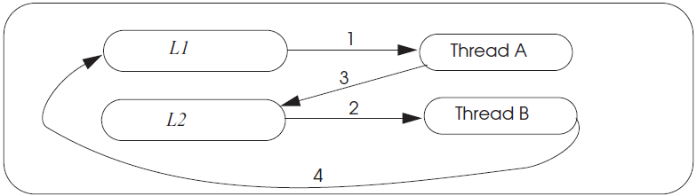
Deadlock wait-for Graph

Slide 18
Deadlock Theory
Four necessary and sufficient conditions for deadlock
Limited access
Resource can only be shared with finite users.
No preemption
Once resource granted, cannot be taken away.
Multiple independent requests (hold and wait)
Don’t ask all at once (wait for next resource while holding current one)
Cycle in wait for graph

Slide 19
Deadlock & Making Progress
Inevitable if using locks in concurrency
1. Waiting for one another
2. Waiting for a lock by some deadlocked one
Correctness arguments ensures correctness, but no progress
Methods
Pessimistic ones: take a priori action to prevent
Optimistic ones: detect deadlocks then fix up

Slide 20
Methods for Solving Deadlock
Lock ordering (pessimistic)
Number the locks uniquely
Require transactions acquire locks in order
Problem: some app may not predict all of the locks they need before acquiring the first one

Slide 21
Methods for Solving Deadlock
Backing out (optimistic)
Allow acquire locks in any order
If it encounters an already-acquired lock with an number lower than one it has previously acquired itself, then
UNDO: Back up to release its higher-numbered locks
Wait for the lower-numbered lock and REDO

Slide 22
Methods for Solving Deadlock
Timer expiration (optimistic)
Set a timer at begin_transaction, abort if timeout
If still no progress, another one may abort
Problem: how to chose the interval?

Slide 23
Methods for Solving Deadlock
Cycle detection (optimistic)
Maintain a wait-for-graph in the lock manager
Shows owner and waiting ones
Check when transaction tries to acquire a lock
Prevent cycle (deadlock)
Select some cycle member to be a victim

Slide 24
Approach 4: Fine-grained Locking + Solving Deadlock
move(dir1, dir2, filename):
if dir1.inum < dir2.inum:
acquire(dir1.lock)
acquire(dir2.lock)
else:
acquire(dir2.lock)
acquire(dir1.lock)
unlink(dir1, filename)
link(dir2, filename)
release(dir1.lock)
release(dir2.lock)
dir.inum is the inumber of a directory
Requires global reasoning about all locks
Need a way to ensure locks are acquired in the same order
Aka., ordered locking

Slide 25
Livelock
An interaction among a group of threads
Each thread is repeatedly performing some operations
E.g., context saving/restoring
But never able to complete the whole sequence of operations
E.g., process the network packets

Slide 26
One-writer Principle
If each variable has only one writer
Coordination becomes easier
Concurrency and read-only data is easy
Guide: Make as much data as you can have only a single writer
Privatization: Make data private to a thread
Allocate on thread stack
Array indexed by thread_id()
E.g. privateData[thread_id()]...
Focus locking scheme on data shared read/write

Slide 27
Reference
Our text book: Chap-5.2
3-easy-pieces: Chap-28

Slide 28
Thread

Slide 29
Virtualization: C/S on a Single Machine
in order to enforce modularity + build an effective operating system
programs should not be able to refer to
(and corrupt) each others’ memory
Virtual memory
programs should be able to
communicate
Bounded buffer (virtualize communication links)
programs should be able to share a
CPU without one program halting the
progress of the other
Thread for multiplexing the processor

Slide 30
Threads = Virtual Processor
API
suspend(), resume()
Need to capture program's state
Value of all registers, all of its memory
Big question: when to suspend/resume a thread?

Slide 31
The yield() System Call
Why yield()? Current thread is waiting for an event
Implementation of yield()
Suspends running thread: save stack pointer and page-table register
Chooses new thread: round-robin fashion until we hit a RUNNABLE thread (perhaps the one that just called yield)
Resumes thread to run: reload state all of this happens as an atomic action
Data structures
threads table, CPUs table, t_lock

Slide 32
YIELD() Implementation
yield():
// Suspend the running thread
// Choose a new thread
// Resume the new thread

Slide 33
YIELD() Implementation
yield():
acquire(t_lock)
id = id of current thread
threads[id].state = RUNNABLE
threads[id].sp = SP
// Choose a new thread
// Resume the new thread
release(t_lock)
Suspend
running thread
A table contains a list of all the current threads and some info about them, one per system
threads
t_lock
A lock protect the thread table (at least for now)

Slide 34
YIELD() Implementation
yield():
acquire(t_lock)
id = cpus[CPU].thread
threads[id].state = RUNNABLE
threads[id].sp = SP
// Choose a new thread
// Resume the new thread
release(t_lock)
Suspend
running thread
A table contains a list of all CPUs and the ID of the thread currently running on them, one per CPU
cpus
Question: why no cpu_lock needed?

Slide 35
YIELD() Implementation
yield():
acquire(t_lock)
id = cpus[CPU].thread
threads[id].state = RUNNABLE
threads[id].sp = SP
do:
id = (id + 1) mod N
while threads[id].state != RUNNABLE
// Resume new thread
release(t_lock)
Suspend
running thread
Choose new
thread
The state could be RUNNING, RUNNABLE (for now)

Slide 36
YIELD() Implementation
yield():
acquire(t_lock)
id = cpus[CPU].thread
threads[id].state = RUNNABLE
threads[id].sp = SP
do:
id = (id + 1) mod N
while threads[id].state != RUNNABLE
SP = threads[id].sp
threads[id].state = RUNNING
cpus[CPU].thread = id
release(t_lock)
Suspend
running thread
Choose new
thread
Resume new
thread
t_lock
Atomically set threads[].state and .sp
Atomically find a RUNNABLE thread and mark it RUNNING

Slide 37
Context Switch

Slide 38
Thread Layer and Processor Layer
A thread runs in thread layer
A thread calls YIELD, enters processor layer
Saves the state of the running thread
General purpose regs + PC + SP + CR3
Chose another runnable thread
Exit the processor layer and enter thread layer
The new thread runs in thread layer

Slide 39
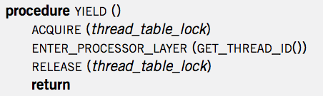
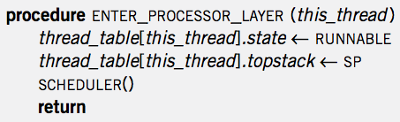
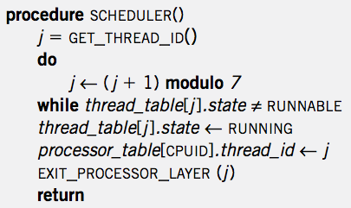

Context Switch
YIELD
ENTER
SCHED
EXIT
YIELD
YIELD
ENTER
SCHED
EXIT
YIELD
App
APP
APP
YIELD
YIELD
YIELD
YIELD
SP-1
ENTER
ENTER
SP-2
ENTER
ENTER
SP-2
SP-1
SCHED
SCHED
EXIT
EXIT
Notes:
Question-1: where is the point of context switch?
Question-2: why not save the PC of a thread?

Slide 40
Creating a Thread
ALLOCATE_THREAD
Allocate a new stack
Push address of EXIT_THREAD() as return address
Push address of starting_procedure as return address
starting_procedure is the start address of a thread
Initialize an entry in thread_table
Set state to RUNNABLE
Stack of a Thread
EXIT_THREAD
starting_procedure

Slide 41
Start the Scheduler
Processor Thread
Create a separate thread for each processor first
Its stack is not used for most of the time
Only used when running scheduler()

Slide 42
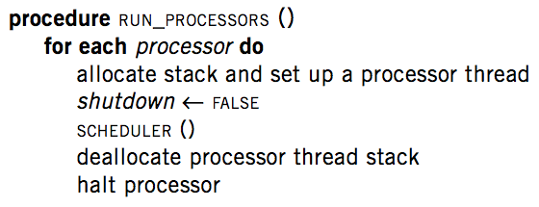
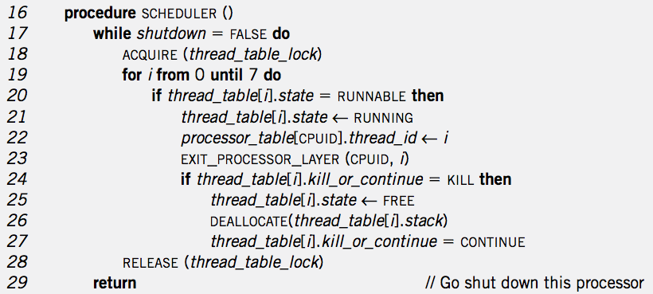
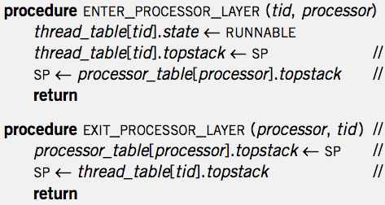
RUN_PROCESSOR
& Create Thread
Thread Create
RUN_PROCESSOR
EXIT_T
MAIN
APP
SCHED
EXIT_P

Slide 43
Thread Exit
1 procedure EXIT_THREAD()
2 ACQUIRE (threadtable_lock)
3 threadtable[tid].kill_or_continue ← KILL
4 ENTER_PROCESSOR_LAYER (GET_THREAD_ID (), CPUID)

Slide 44
Destroy a Thread
DESTROY_THREAD
One thread kills another thread
Problem: the target thread may be running, thus the calling thread cannot just free its resource
Solution: asynchronization: set KILL and return
Wait for the thread to be destroyed when SCHEDULER

Slide 45
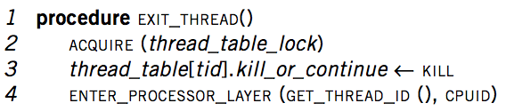
Thread Exit
Thread
Exit
APP
APP
EXIT_T
SCHED
YIELD
ENTER_P
EXIT_P
EXIT_P
ENTER_P

Slide 46
The New Scheduler()
16 procedure SCHEDULER ()
17 while shutdown = FALSE do
18 ACQUIRE (threadtable_lock)
19 for i from 0 until 7 do
20 if threadtable[i].state = RUNNABLE then
21 threadtable[i].state ← RUNNING
22 processor_table[CPUID].thread_id ← i
23 EXIT_PROCESSOR_LAYER (CPUID, i)
24 if threadtable[i].kill_or_continue = KILL then
25 threadtable[i].state ← FREE
26 DEALLOCATE(threadtable[i]. stack)
27 threadtable[i]. kill_or_continue = CONTINUE
28 RELEASE (threadtable_lock)
29 return // Go shut down this processor

Slide 47
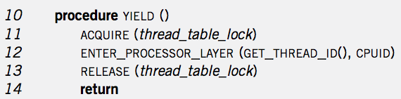
Context Switch
YIELD
ENTER
SCHED
EXIT
YIELD
YIELD
ENTER
SCHED
EXIT
YIELD
App
MAIN
APP
APP
MAIN
YIELD
SCHED
SCHED
YIELD
YIELD
SCHED
SCHED
SCHED
YIELD
ENTER
EXIT
EXIT
ENTER
ENTER
EXIT
EXIT
SP-1
SP-2
SP-2
ENTER
SP-1
SP of Processor Thread
SP of Processor Thread

Slide 48
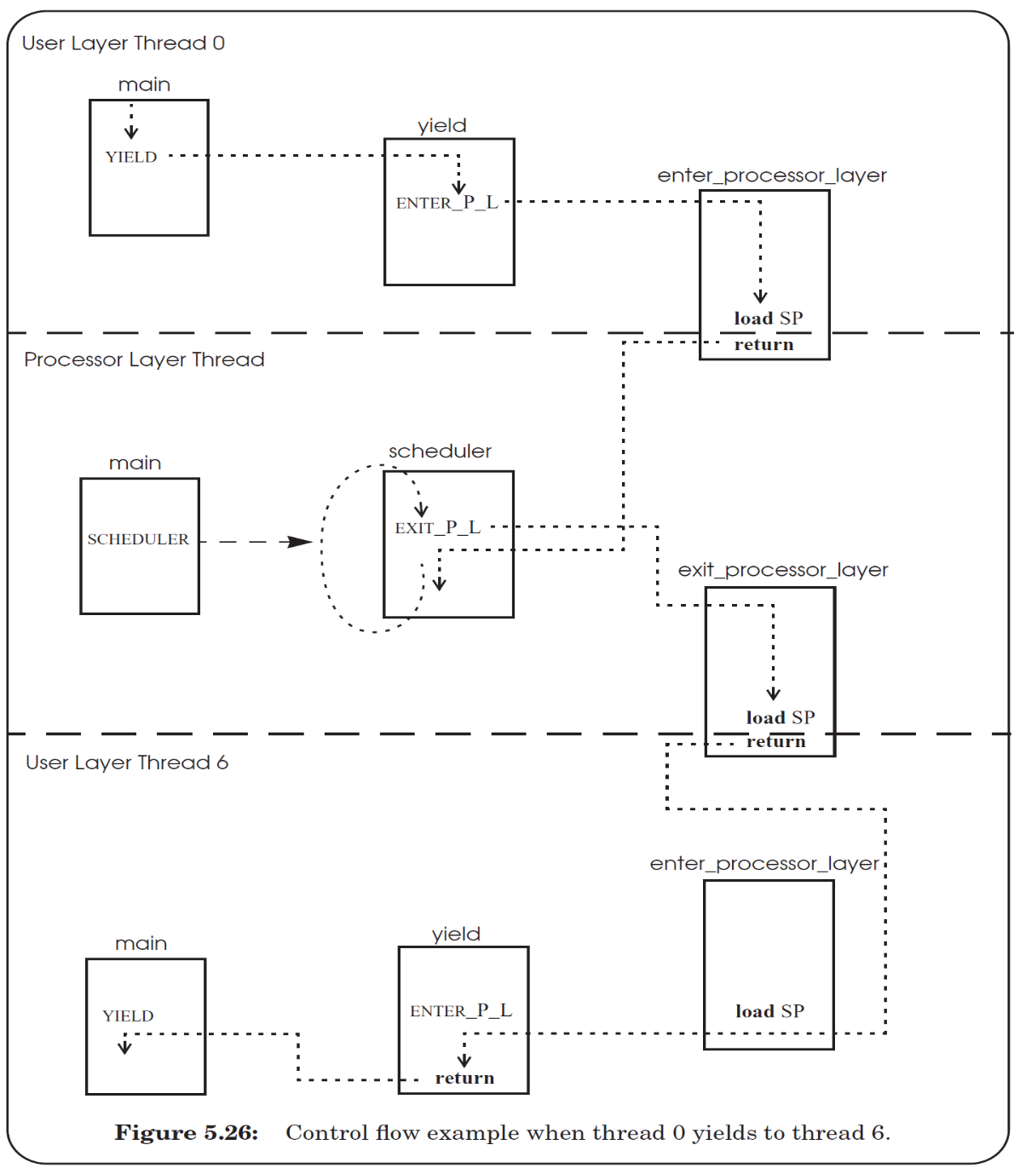

Slide 49
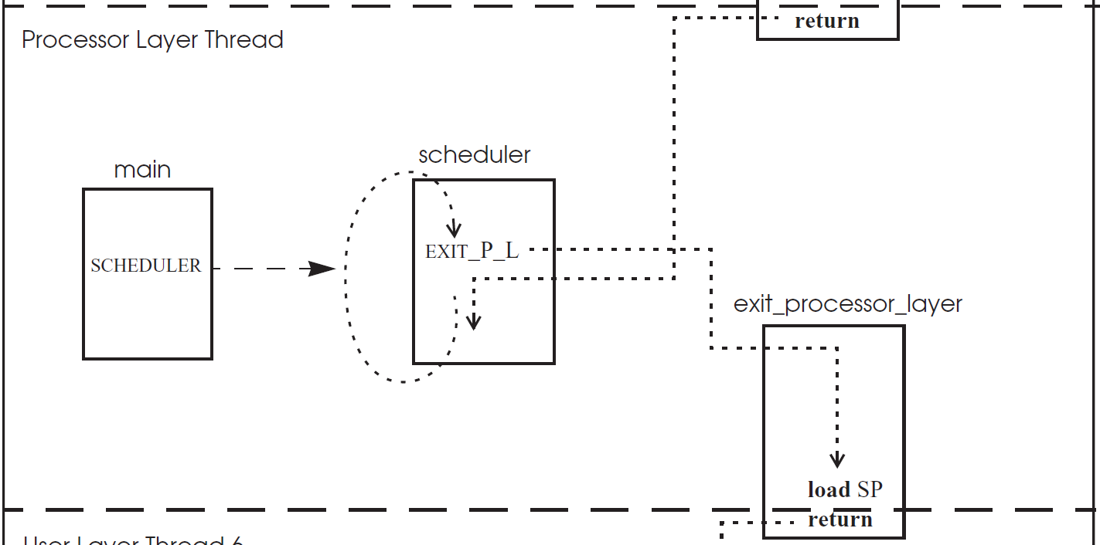

Slide 50
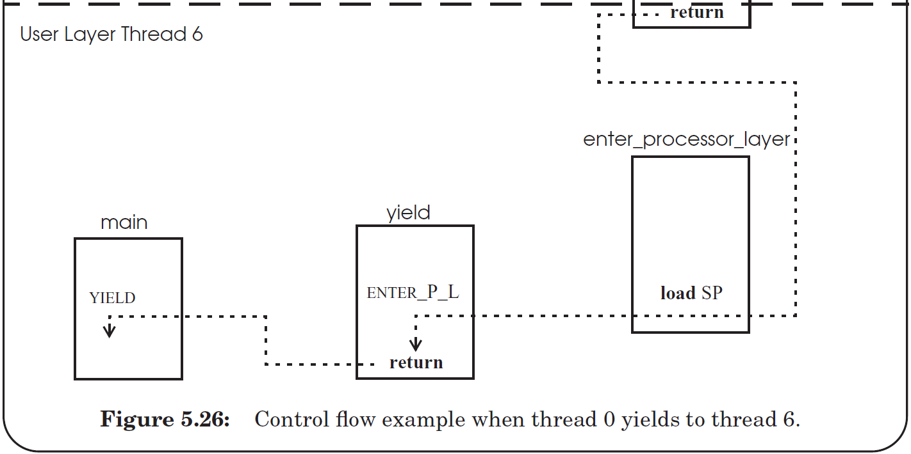

Slide 51
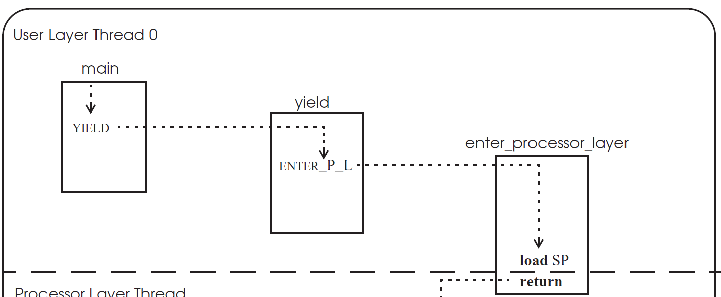

Slide 52
thread_table_lock
1
2
11
12
3
4
7
8
5
6
9
10

Slide 53
thread_table_lock
1
2
3
4
5
Stack changes to
processor thread
6
7
8
9
10
11
Stack changes back
12

Slide 54
First time of a thread
1
2
3
4
5
Stack changes to
processor thread
6
7
8
Q: still hold the lock?
9
10
11
start_procedure()
Stack changes back
Notes:
Answer: when create a new thread, the stack of the thread must be initialized to include YIELD(), and push the return address to the middle of YIELD(), so that when after return, the new thread will first release the lock, just as the previous slide. Then return again to the start_procedure (by pushing the address to the stack too).

